Slide 1
Data Visualization of Bird Strikes between 2000 – 2011
Created By
Harshita Choubey

Slide 2
Introduction
Analyze FAA data to identify bird strike patterns and develop targeted mitigation strategies for high-risk phases of flight, prioritizing jet-engine aircraft safety.
Integrate advanced technologies like radar and AI for early detection of bird activity, aiming to reduce collision risks and enhance aviation safety around airports and flight paths.
Develop and implement educational programs to raise awareness among aviation personnel about bird strike hazards and best practices for reporting and mitigating risks during flight operations.

Slide 3
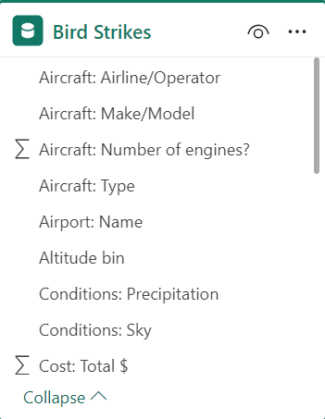
Details of dataset
Year, Altitude, Aircraft Type: Data on bird strike incidents categorized by year, altitude range (low, medium, high), and aircraft type (commercial jets, small propeller aircraft, etc.).
Impact and Cost: Severity of bird strike impact recorded (minor to catastrophic damage) along with total cost implications including repair costs, downtime, and associated expenses.
Cloud Condition and Pilot Warning: Weather conditions noted during strikes (cloud cover, visibility, precipitation) and whether pilots received warnings about bird activity before strikes (Yes/No).
Airport and Aircraft Size: Identification of airports most frequently affected by bird strikes and classification of aircraft size based on passenger capacity or weight class (small, medium, large).,

Slide 4
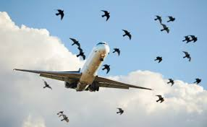
Main KPIs
Total Impact cost
Number of Bird Strike
Altitude BIN

Slide 5
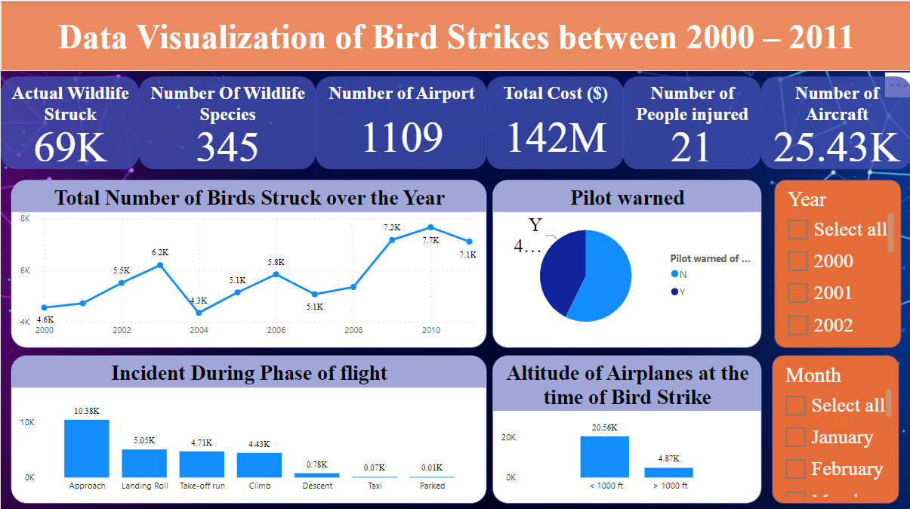
My Design

Slide 6
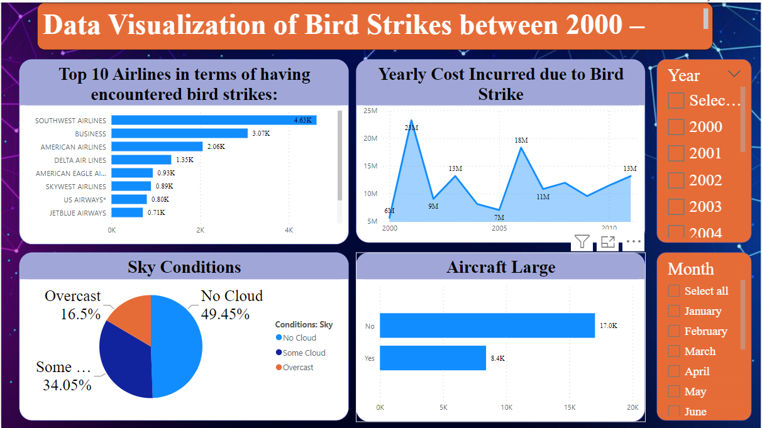
My Design

Slide 7
Thank you

